Slide 1
Dinic's ALGORITHM
Presented by SRIJA KATTAMGUR

Slide 2
agenda
Introduction
Why its better?
Overview
example
Time complexity
Applications

Slide 3
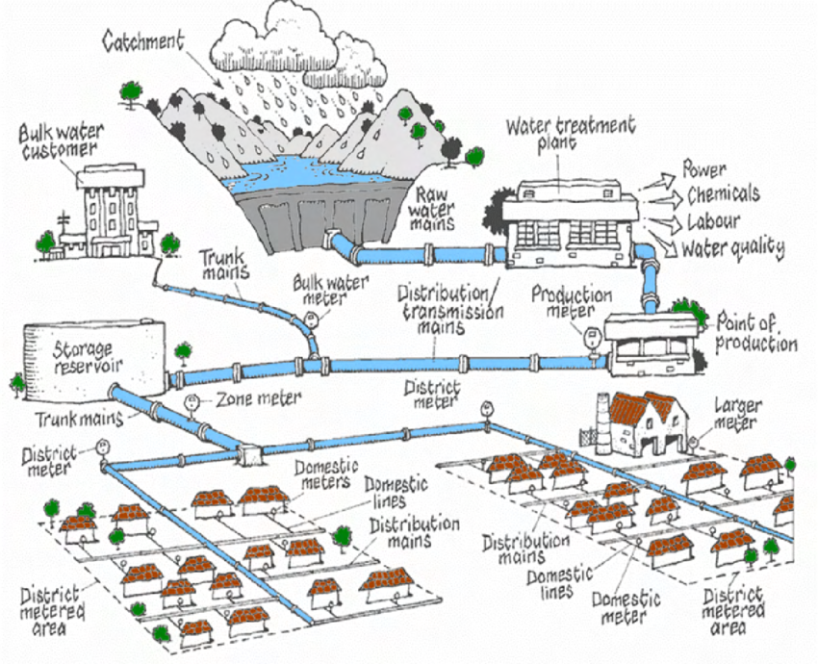
Introduction
Dinic's Algorithm solves the Maximum Flow problem.
Think of it like a water pipe network: each pipe has a capacity.
Goal: Find the maximum amount of flow from the source (S) to the sink (T) without exceeding capacities.

Slide 4
WHY DINIC'S IS BETTER?
Ford-Fulkerson can run indefinitely or inefficiently in some cases.
Dinic's builds level graphs to group shortest paths.
Pushes flow more efficiently using DFS on these paths.
Faster on large or layered graphs.

Slide 5
OVERVIEW OF DINIC'S ALGORITHM
• Dinic's works in repeated phases:
• 1. Use BFS to build a level graph.
• 2. Use DFS to push flow through shortest paths.
• 3. Repeat until no more augmenting paths exist.
• Limits unnecessary backtracking, improving performance.

Slide 6
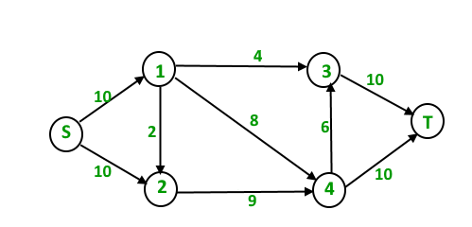
EXAMPLE SETUP

Slide 7
Time complexity
• General graphs: O(V² E).
• Unit capacity graphs: O(E √V).
• Efficient on large and layered graphs.
.

Slide 8
Applications
Real-world uses:
Data networks — Optimize data packet routing without overloading links.
Traffic networks — Maximize vehicle flow through roads and intersections.
Project scheduling — Allocate time and resources under constraints to maximize completed tasks.

Slide 9
Questions
Q: When does Dinic’s Algorithm terminate?
A: It terminates when BFS can no longer find a path from the source to the sink in the residual graph—meaning no more augmenting paths exist.
Q :Why do we use BFS in Dinic’s Algorithm?
A: BFS is used to build a level graph, grouping nodes based on their distance from the source. This helps guide the DFS to push flow efficiently through shortest paths.
Q: Can Dinic’s Algorithm handle negative edge weights?
A: No. Dinic’s Algorithm, like most max-flow algorithms, assumes non-negative capacities. Negative weights violate the flow conservation and capacity rules.

Slide 10

Reference: https://youtu.be/duKIzgJQ1w8?si=XlyhFaAJ-V5Ub4zS
.

